Slide 1
REMEMBERING PARTITION

Slide 2
You remember that village where the border ran
Down the middle of the street,
With the butcher and baker in different states?
Today he remarked how a shower of rain
Had stopped so cleanly across Golightly’s lane
It might have been a wall of glass
That had toppled over. He stood there, for ages,
To wonder which side, if any, he should be on.
[Paul Muldoon, “The Boundary Commission,” 1980]

Slide 3
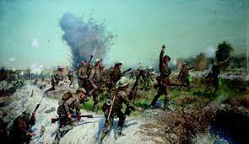

Slide 4
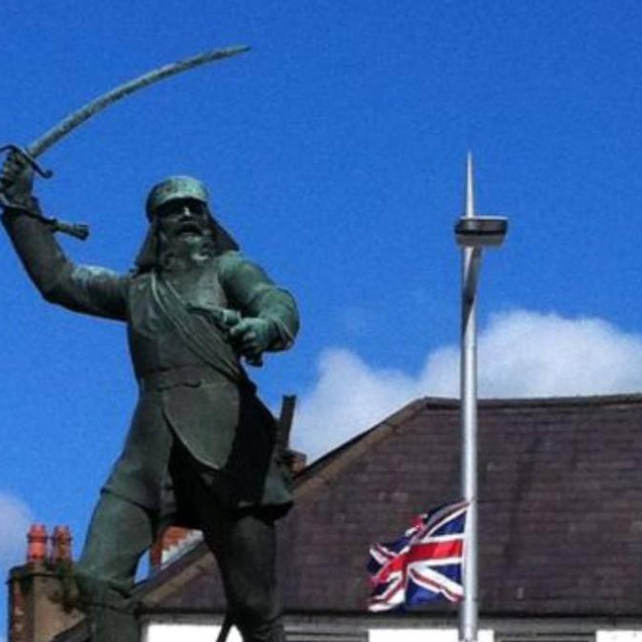

Slide 5
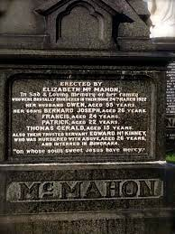

Slide 6
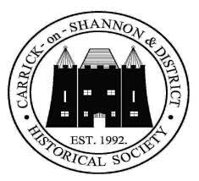

Slide 7
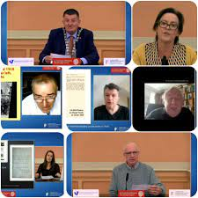

Slide 8
“Every county in the Republic of Ireland had official commemorations, which often extended from the year before and continued into the year after [. . .]. The longevity of the core and extended Easter Rising commemorations meant that there were more opportunities for alternative narratives that bypassed and even contradicted the traditional, military pageantry of the state. This openness to long-term and alternative commemorations was not present in Northern Ireland. The Somme was commemorated by male-dominated events, marches and murals largely within unionist communities (with some encroachment into mixed or shared areas), and the Easter Rising was limited to events, marches and murals in nationalist areas.”
[Laura McAtackney, “Public Memory, Conflicts and Women: Commemoration and Contemporary Ireland,” 2020]

Slide 9
“Despite its profound impact on the shape of modern Ireland, there are no monuments to partition.”
[Robert Lynch, The Partition of Ireland, 1918-1925, 2019]
“Partition may have facilitated the establishment of Northern Ireland, but there was little appetite to commemorate a border that cut across unionist and Protestant communities and institutions, including the Orange order and Protestant Churches, as indiscriminately as Catholic and nationalist ones.”
[Darragh Gannon and Fearghal McGarry, “Remembering 1922,” Ireland 1922: Independence, Partition, Civil War, 2022]

Slide 10
Partition “was neither the most desired nor most readily envisioned outcome to the conflicts that preceded its implementation. With the United Kingdom, Ireland, and even Ulster all divided, no previously ‘imagined community’ was left intact.”
[Peter Leary, Unapproved Routes: Histories of the Irish Border, 1922−1972, 2016]
“Unionists had not demanded or campaigned for a parliament of their own and, while they accepted that some form of defensive partition was now inevitable, they baulked at the potential imposition of devolution, which was being imposed merely to facilitate the smooth running of the Home Rule settlement they had done so much to oppose.”
[Robert Lynch, The Partition of Ireland, 1918−1925, 2019]
“I think [the establishment of Northern Ireland is] more something to be recognised [than celebrated]. I’m very pleased and proud to be in the UK and feel it’s the best way forward. It would have been better if all of Ireland had stayed in the UK.”
[Tom Elliott, former Ulster Unionist leader and MP – 2021 Interview]
“Ulster Unionism was conceived not as a project of social transformation but rather as a ‘loyal’ counter-revolutionary defence of established Protestant liberties and of British imperial culture in Ireland [. . .]. The whole rationale of the new state was identified with the protection of Protestantism and it was the most reactionary elements of British state iconography – the symbols of royalism, Protestant supremacy and Empire – that were appropriated by Unionists as the icons that mortared their sense of Britishness.”
[Joe Cleary, Literature, Partition and the Nation State, 2002]

Slide 11
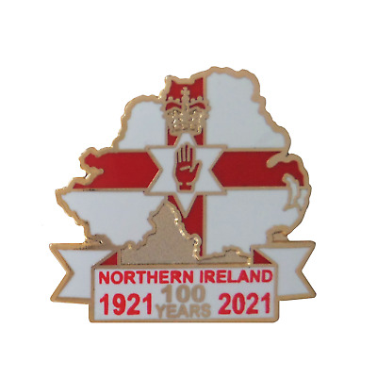
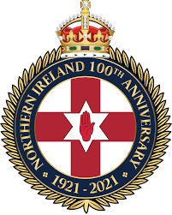

Slide 12
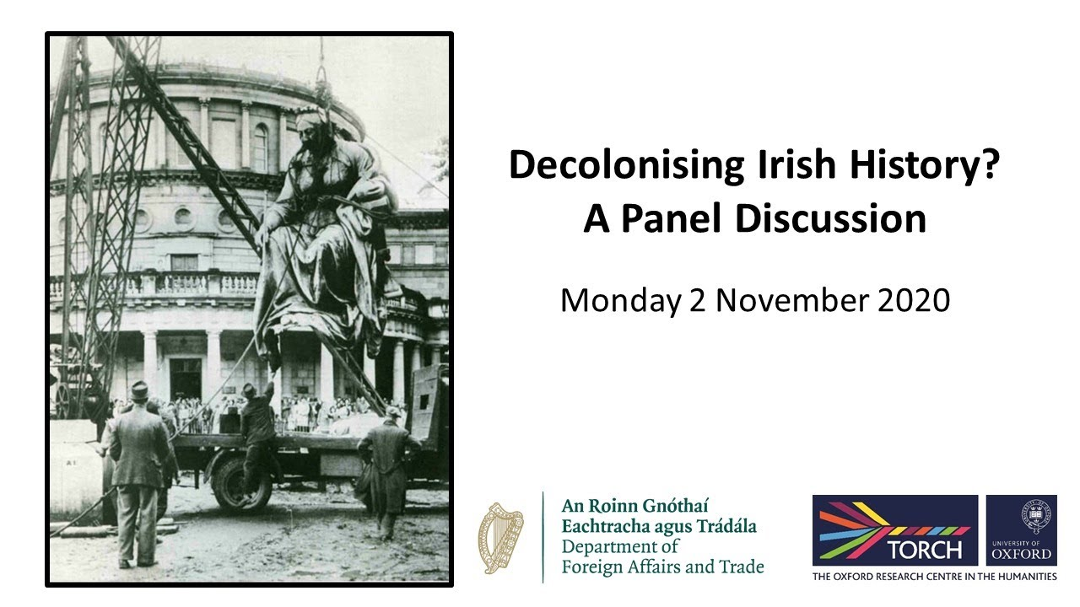

Slide 13
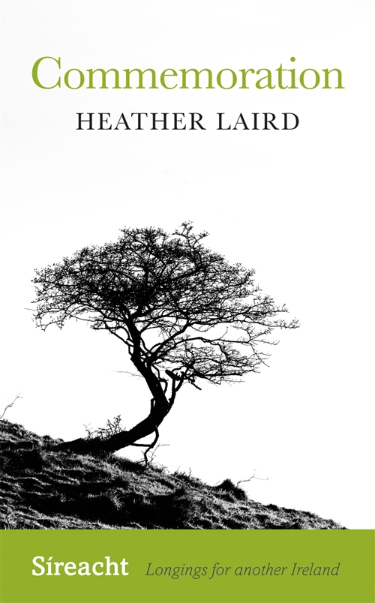

Slide 14
“The whole question of partition was for a long time very vague – partition or exclusion? It was vague, firstly, as to whether it was temporary or permanent. It was vague, secondly, as regards the area affected, whether it covered four, five, six or nine counties. It was further confused with the question of separate treatment for Ulster, that is, what was called ‘Home Rule within Home Rule.’”
[Cited in Robert Lynch, The Partition of Ireland, 1918−1925, 2019]

Slide 15
“Partition is often defended by its advocates on the basis that it is the only practicable solution in situations where two antagonistic national groups with conflicting aspirations to self-determination inhabit a shared territory. The strategy’s major deficiency, however, is that in regions where the people concerned are geographically intermingled, the attempt to manufacture ethnically homogeneous states, or states with secure ethnic majorities, cannot be accomplished without extraordinary communal violence. This violence does not end with the act of partition: violence is not incidental to but constitutive of the new state arrangements thus produced.”
[Joe Cleary, Literature, Partition and the Nation State, 2002]
“One of the great ironies of partition is that it so often engenders the very thing it is intended to avert. Far from the ‘clean cut’ highlighted by its supporters, the partitions of the twentieth century have resulted in at best messy compromise and at worst inspired civil war, inter-communal conflict and the oppression of the new minorities it inevitably creates.”
[Robert Lynch, The Partition of Ireland, 1918−1925, 2019]
“[T]he bedrock argument for partition is always that since the only available alternatives are catastrophic, then partition is by default a positive good, a defence against disaster. It is this apparently narrow choice between ‘partition’ and ‘disaster’ that is ultimately false and restrictive [. . .]. Partition may be defended on the basis that to dismantle it might lead to even worse catastrophes. But this invocation of apocalypse around the bend can all too easily obscure the fact that for some groups, Northern Irish nationalists, Palestinians most of all – partition was never a check against future catastrophe: it was the political catastrophe they have since been trying, in the interests of self-determination, to overcome.”
[Joe Cleary, Literature, Partition and the Nation State, 2002]

Slide 17
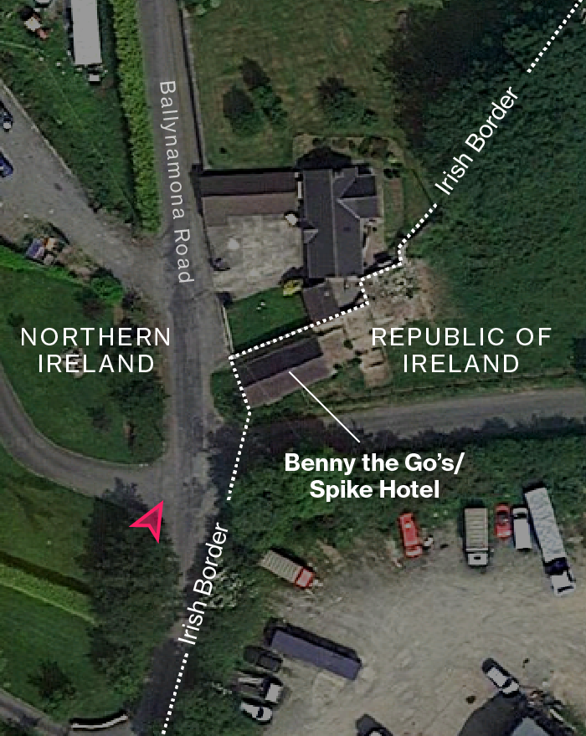

Slide 18
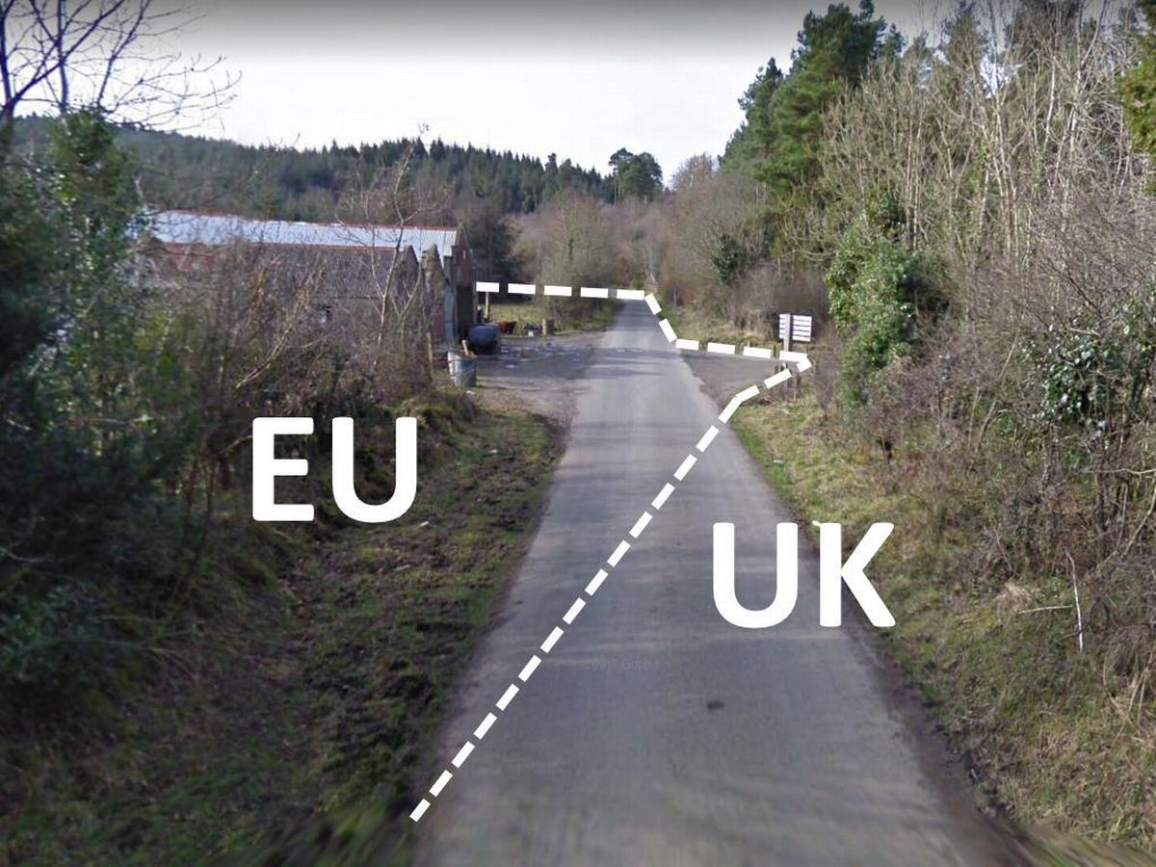

Slide 19
